Slide 1
Introducing Casal2 for assessments
Ian Doonan
7 January 2022

Slide 2
Topics
NZ fisheries context
CASAL
Casal2
Introduction to example assessment (hake: HAK 1)
How to run Casal2 from R
Input file syntax
Relevant example input file segments for HAK 1

Slide 3
Casal2 will replace CASAL
CASAL development has ceased
but it still works for 2000 era assessment models
Casal2 is our version of the next generation integrated assessment tool
includes newer assessment ideas
more maintainable
easier to expand

Slide 4
NZ fisheries context
Management based in biomass targets and limits
B_{current} as %B₀
e.g., common soft limit is 20% B₀
Not common to use Baranov catch equation (F)
i.e., common to use exploitation rate
still has not been included into Casal2
Bayesian analyses with MPDs used to select final runs for management
→ MCMC used on final runs
random effects not really needed so it is not implemented yet
Usually, management based on 5-year projections using the MCMC parameter vectors
(sometimes 10 years)

Slide 5
CASAL
Generalised software that implements a fairly standard age- (or length-) structured discrete time-step population dynamics model
integrated assessment
Self-documented input files
Conceived 1999, version 1.0 available in 2001
Extensively used within New Zealand (21 years)

Slide 6
Why CASAL?
Design objectives:
A flexible, generalised statistical age or length structured model
Assisting scientists
Standard, validated code base with a common knowledge pool of problems and solutions
Standardised interface that ‘self-documents’ each model
Assisting stakeholders
Standardised terminology
Standardised mathematical description contained in one place
Consistent outputs allowing easy comparison between models, over time, and across stocks
Replaced various individuals’ own programs

Slide 7
Population
Sex, maturity, area, stock structure options
Flexible time period, annual cycle, with some additional optional population processes
Multiple fleets and fisheries occurring in single or multiple areas
Optional catch-equations: Baranov or exploitation rate
Alternative forms of age-length relationships
Selectivity/ogive definitions
Migrations

Slide 8
Estimation & observation
Specifies data for observations
Likelihoods
Penalties
Data specs
Abundance/biomass indices
Age & length compositions
Tagging
Migration & maturation
Age & length (growth)
Estimation
Specify parameters to estimate
Their bounds
Priors

Slide 9
Outputs
Output quantities
e.g., fits to observations
SSB over model years
“Pseudo” observations
Pull out expectations for some population slice
e.g., age composition of the SSB over fishery history
Projections

Slide 10
Has it been useful?
Assisted in having standard approach
Consistent results
Transfer of scientist skills between stocks/assessments
Allows more efficient use of time
Helped reduce errors
Aid bug detection
Standardised output and interpretation
Allowed for more efficient flexibility
Allows faster comparison of alternatives model assumptions
Has a lower barrier to entry
Notes:
Read

Slide 11
Problems with CASAL…
Some problems do not fit the model paradigm
e.g., time-varying parameters limited to a50 in selectivities
Observation rich and “large” models can be unwieldy and too slow to be useful
Slow and difficult to use as operating model – simulation model experiment
Slow and difficult to use as an MSE tool
Some ideas about parameter uncertainty/ variability and how they may change over time cannot be implemented within the current framework
“Hard-wired” fisheries concepts
Fixed to 2000 assessment ideas

Slide 12
Why not modify CASAL?
“Not the best” code architecture design
Complicated underlying code
Makes it difficult for experienced scientists to check what's happening
Difficult to modify
Modern methods for code validation difficult to implement
Hard-coded 32-bit minimiser and code implementation in some places
Doesn’t interface easily with other software
The drivers for developing CASAL still exist → Casal2

Slide 13
Casal2 design objectives
Up-to-date flexible age- or length- structured stock assessment modelling tool
length- based still not achieved
Easy to learn, use, and adapt to new assessments
Encapsulates ‘best practise’ in its methods
Allows for the production of ‘standard outputs’ for management and reporting purposes
not achieved
Fully documented
almost achieved

Slide 14
Casal2’s code objectives
Open source architecture
Allows for different type of use
“plays nice” with python/R or other software
Easily extended (C++ code modification)

Slide 15
Constraints
Must replicate most of the current CASAL assessments
Must not block any future (unforeseen) model structure
Must be self-validating and include modern code design elements
Self contained 3rd party code and build enviroment
Integrated unit tests and build validation tests
Usable in MSE/simulation studies
Use no (very few) defaults so all model and observation characteristics have to be specified, as well as what outputs to report

Slide 16
CASAL key concept: the partition: numbers-at-age by population strata
Partition = “matrix” of population splits (rows) and ages (columns)
CASAL: strata are hard-wired
sex, area, mature, stock
Some strata can have one or more levels/factors: others are fixed
sex has two: male and female
area has specified number (e.g., 2 here)
Two categories: sex (male & female) and area (spawning & feeding)
→ 4 rows: male.spawning female.spawning male.feeding female.feeding
Retained in Casal2
but made generic

Slide 17
Casal2 key concept: the partition: numbers-at-age by population strata
Casal2 population splits are generic
Casal2 has no “hard-wired” knowledge of what population categories and factors represent: meaning is user defined by the processes that are specified to operate on them
→ Any population split can be conceptualised in the Casal2 partition
e.g., species
To have meaning, there must be a process to operate on them
Otherwise a function must be coded for it, documented, and tested
Species can use currently available Casal2 processes
e.g., recruitment from within the species, fishing
To simultaneously catch two species in the same fishery, new code would have to be written

Slide 18
Casal2 population modelling concepts
Includes the usual suspects
Ageing, mortality, recruitment, maturity or maturation, etc.
Adds multi-species, -sex options
Adds interdependent processes
density dependent growth, mortality, etc.
Adds time-varying parameters
Adds parameter transformations to enable better convergence properties
Allows for the usual observations and likelihoods

Slide 19
Current state
CASAL model validation and comparison
based on 6 test assessments adapted to test most CASAL features in Casal2
Unit tests
System tests
14 models which test specific groups of Casal2 functionality
Currently, Beverton-Holt is the only stock-recruitment relationship

Slide 20
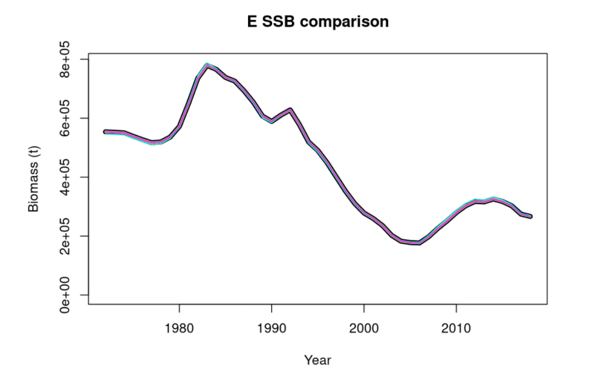
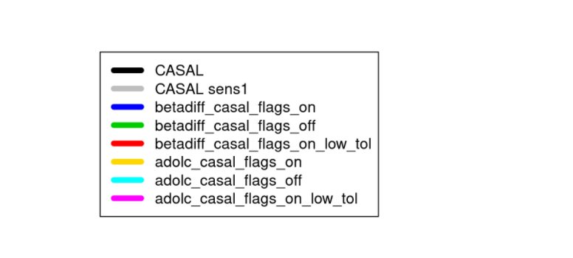
compare_HOK.MPD.html

Slide 21
Introduction to example assessment (hake (Merluccius australis), HAK 1 stock)
Purpose: test Schnute growth & nuisance q catchability
Directory for this test case:
Based on
https://github.com/NIWAFisheriesModelling/CASAL2/tree/master/TestCases/primary/HAK/Casal2/adolc_casal_flags_off
Dunn, M.R. (2019). Stock assessment of Sub-Antarctic hake (part of HAK 1) for 2018. New Zealand Fisheries Assessment Report 2019/52. 29 p

Slide 22
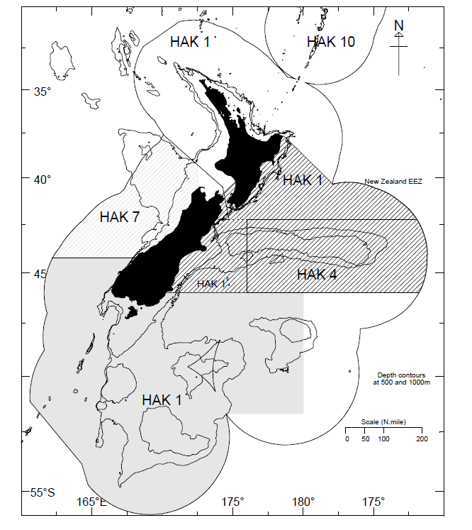
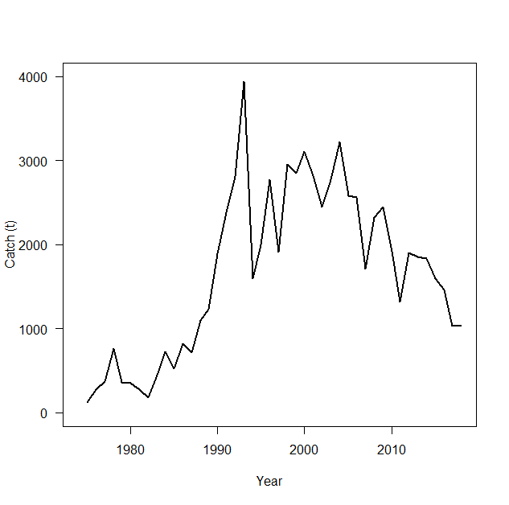
HAK 1: Sub-Antarctic
Biology
Max age ~25 yr
Max length: 100 cm males; 120 cm females
Matures between 6 to 8 yr
von Bertalanffy growth model
underestimates ages of large fish
→ Schnute’ s model used
M = 0.19
Catches: 1975 to 2018

Slide 23
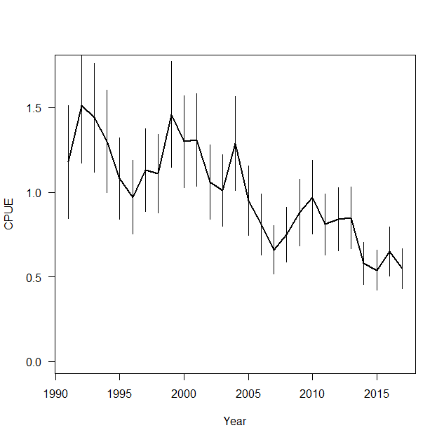
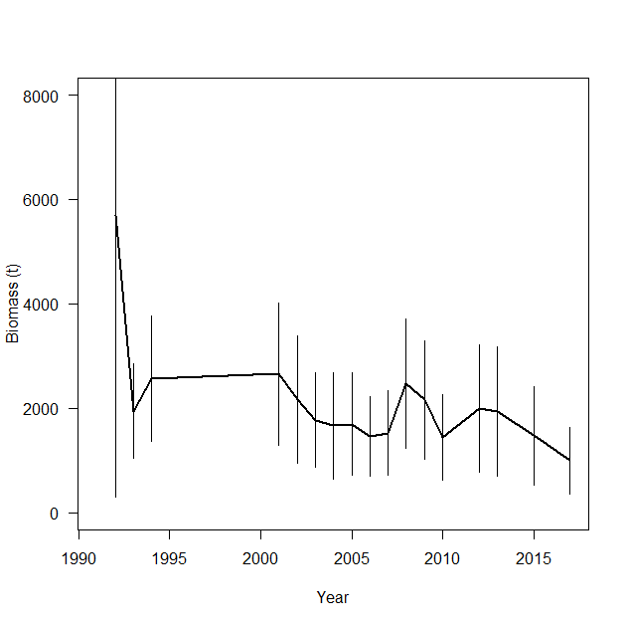
CPUE
Proportion mature fish spawning 100%
Proportion recruits that are male 50%
Ageing error 8%
Max exploitation rate 70%
YCS 1974 to 2016
DATA
Observer age data (commercial fleet)
CPUE abundance series (1991 to 2017)
Trawl surveys 1992 to 2017
Survey biomass

Slide 24
HAK 1 estimated parameters
Total 51
Virgin biomass
YCS (43)
catchability (2)
Fishery ogive (2)
Survey ogive (2)
CPUE process error

Slide 25
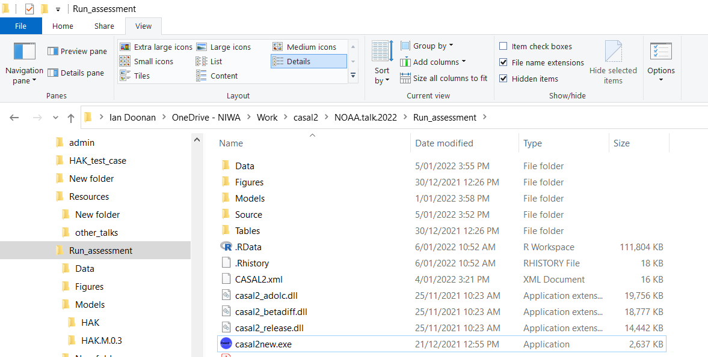
Directory structure for an assessment

Slide 26
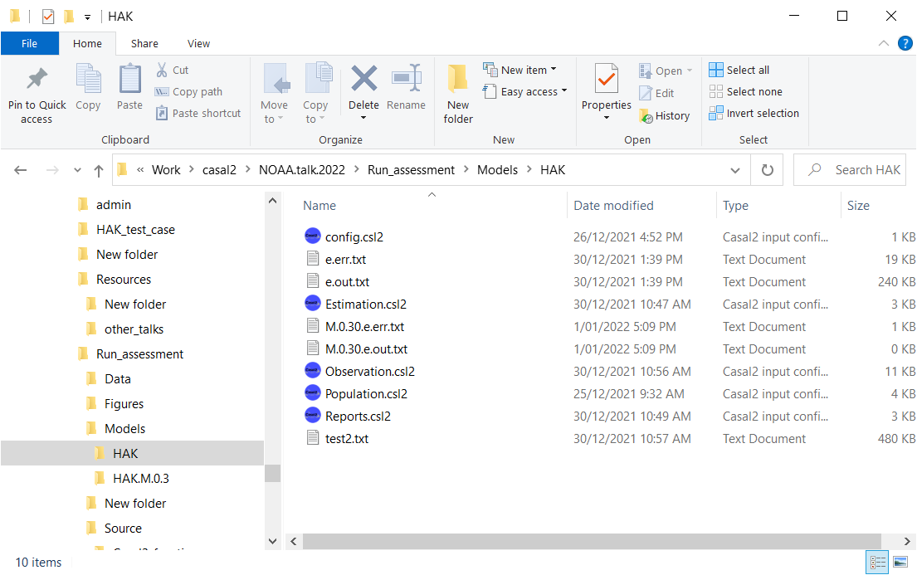
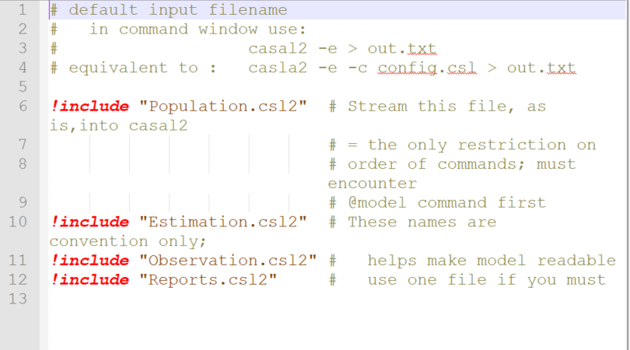
Input files
Casal2 default: file config.csl2
all supporting files in the same directory

Slide 27
Run model
Usually use a command box format
casal2 –e > out.txt 2> err.txt
“-e”: MPD estimation run
out.txt will hold the results
err.txt will hold warning and error messages
Default input file is config.csl2
otherwise use: casal2 –e –c filename > out.txt 2> err.txt
In R:
runCasal2() generates this command and runs it via system2()
Source directory: Run_assessment/Source/Casal2_functions/

Slide 28
Usual run modes
-r Run model once with initial parameter values
-m MCMC mode
-p Projection modes
Other helpful switches
-i <file> Use initial values in file to start run

Slide 29
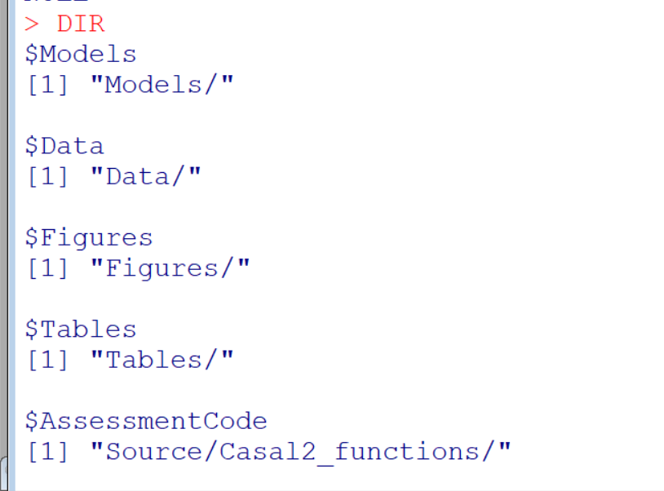
Run model from R
Scripts in Run_assessment/Source
(0)setup.directories.R
(1)run.HAK.assessment.R
(2)HAK.get.results.R

Slide 30
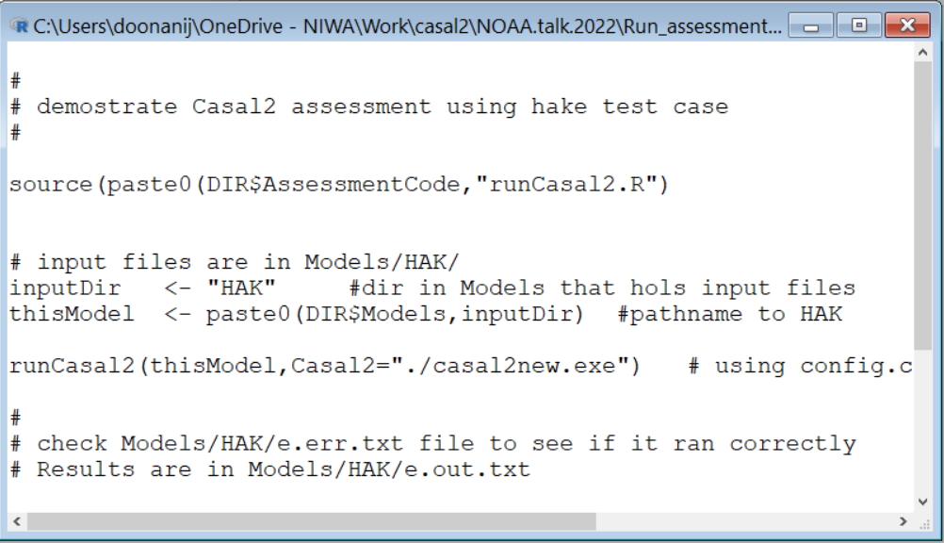
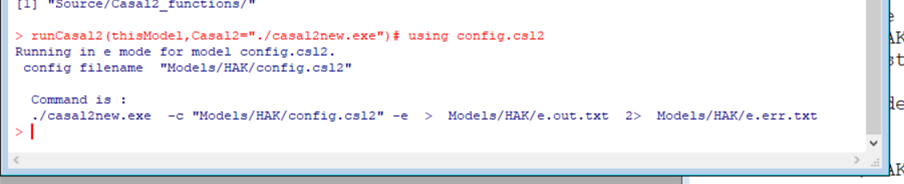
Run model from R
(1)run.HAK.assessment.R

Slide 31
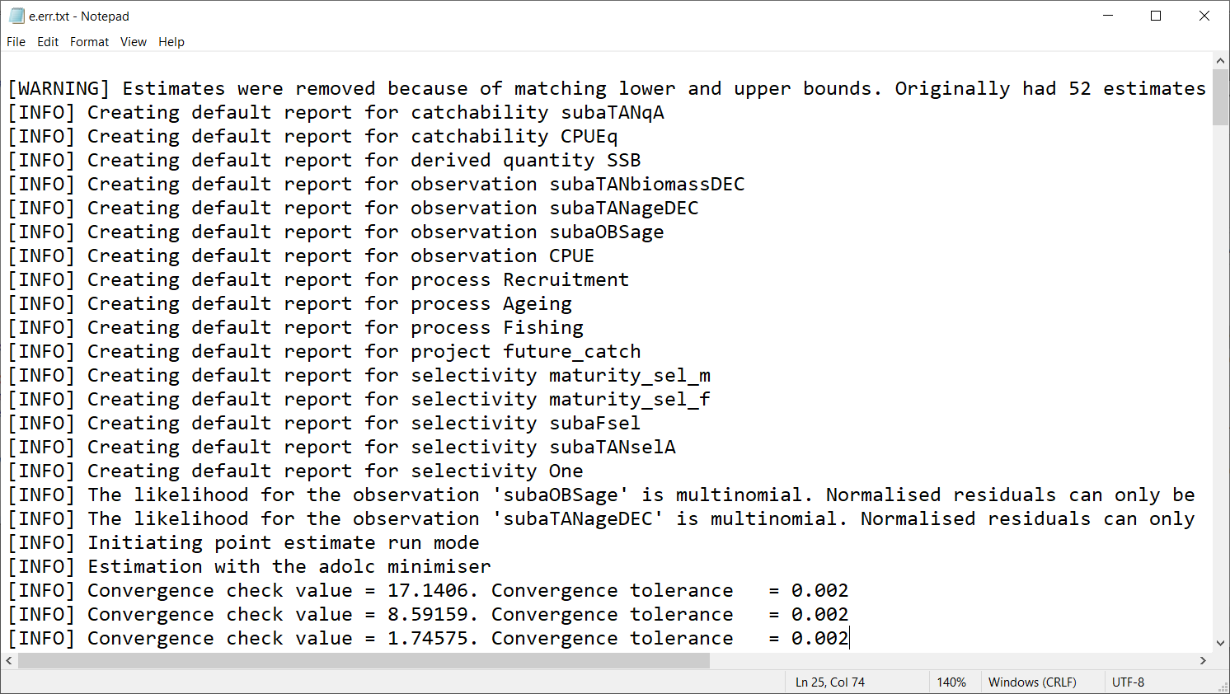
e.err.txt

Slide 32
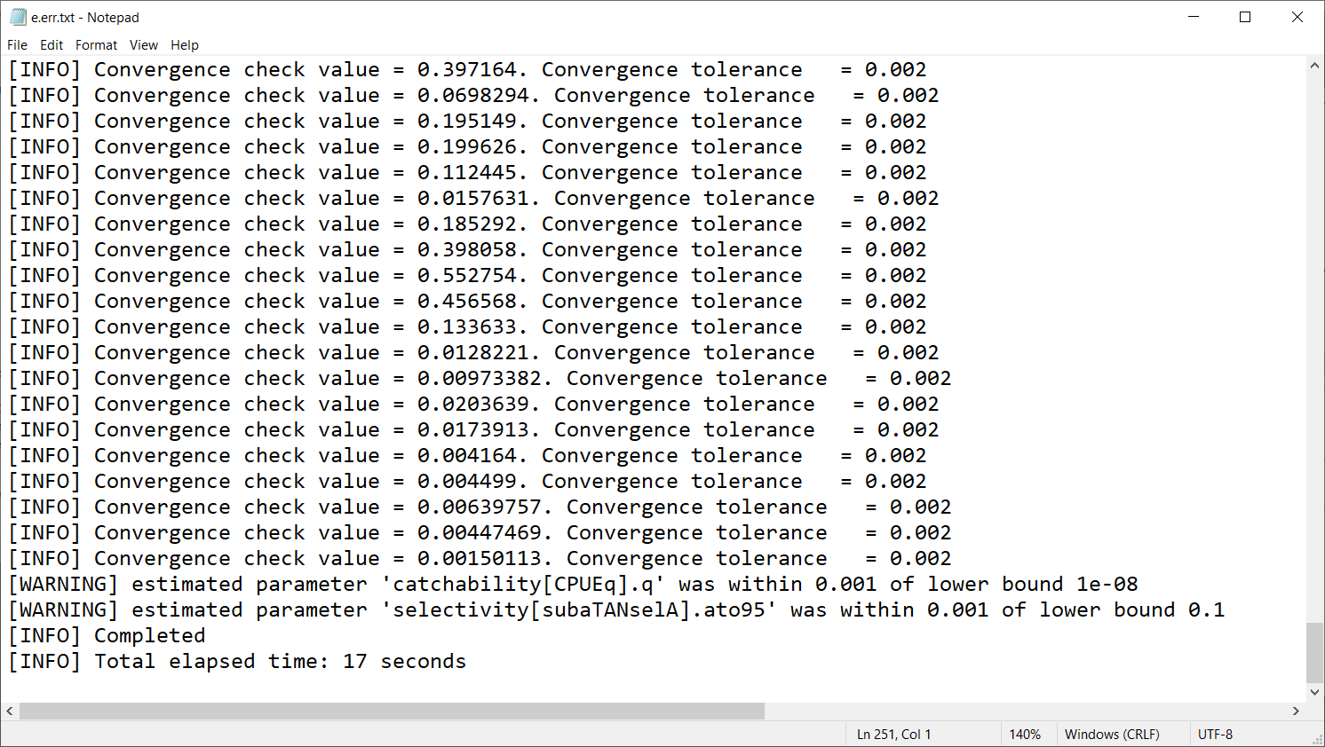

Slide 33
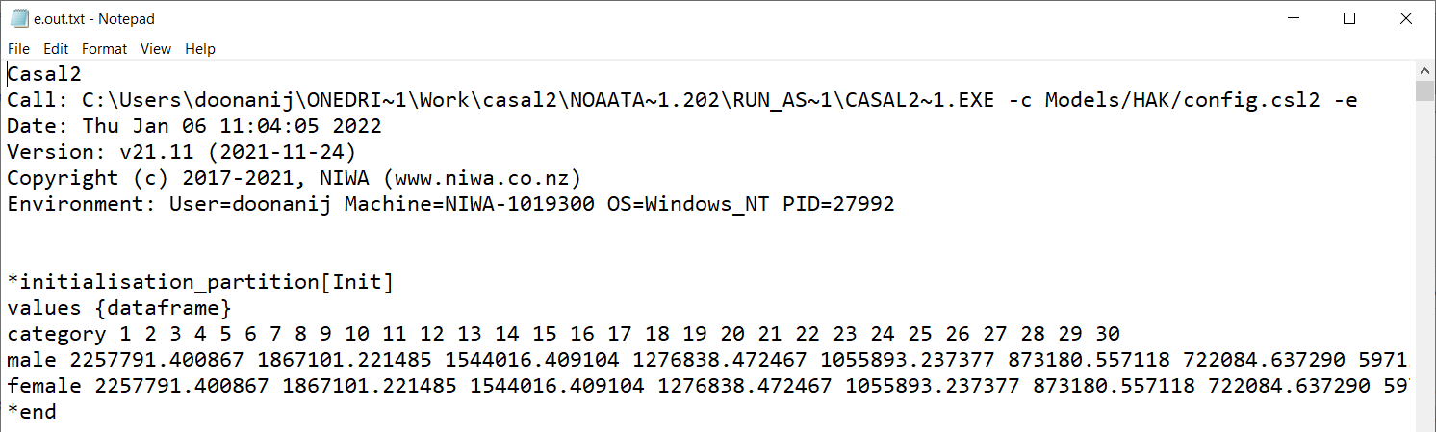
e.out.txt
Result blocks:
*initialisation_partition[Init]
*end

Slide 34
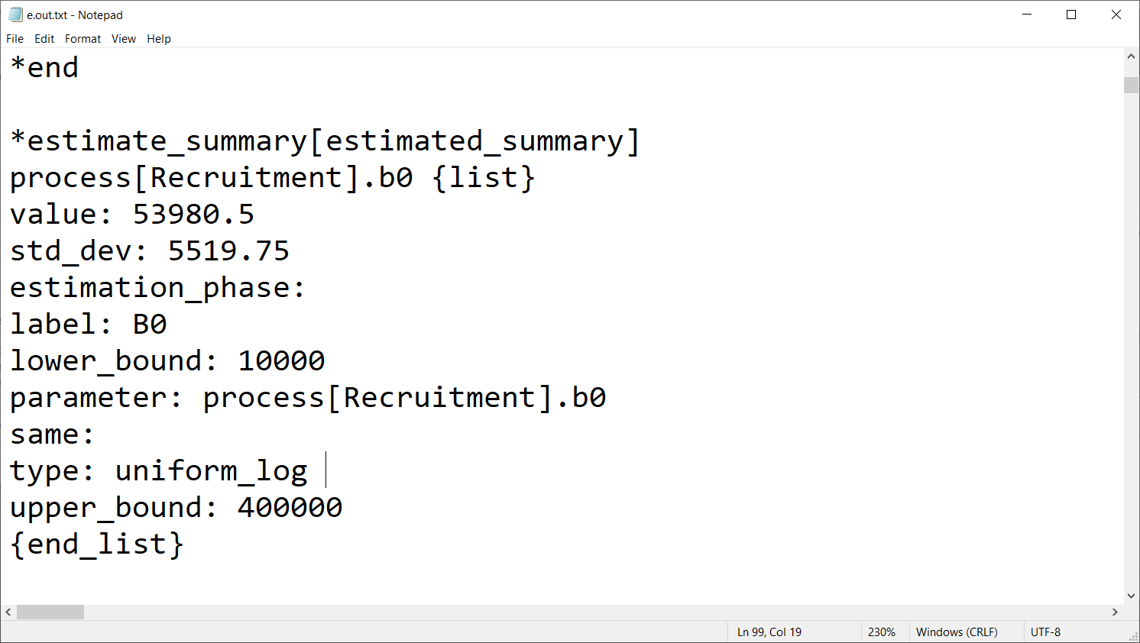
Estimate name within Casal2

Slide 35
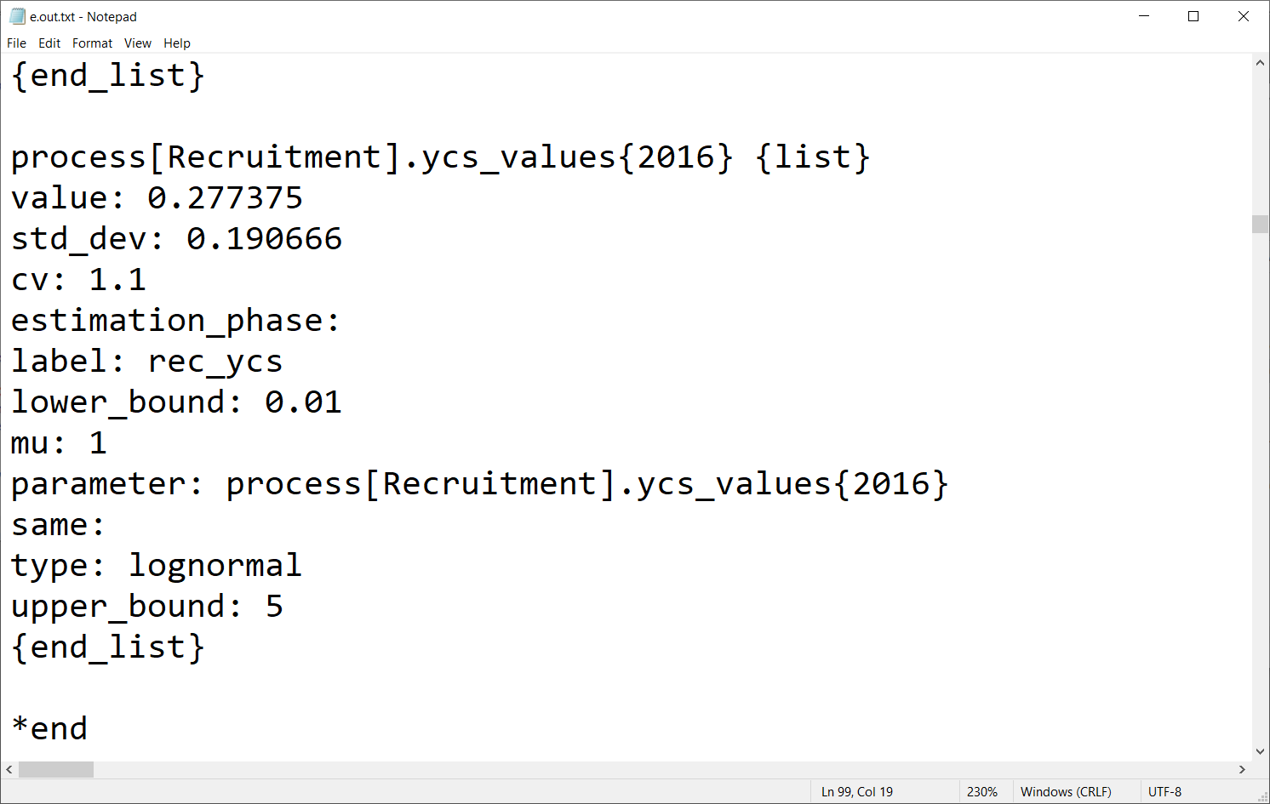
Estimate name within Casal2
elements within a vector

Slide 36
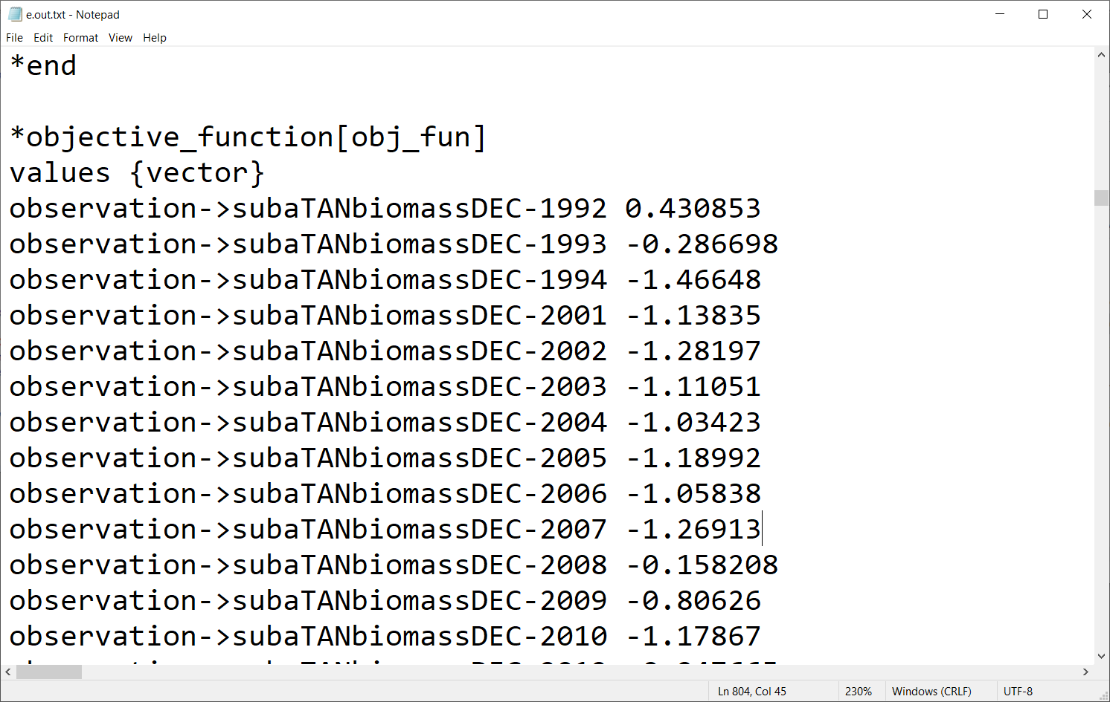
We have an R function that adds these over an observation

Slide 37
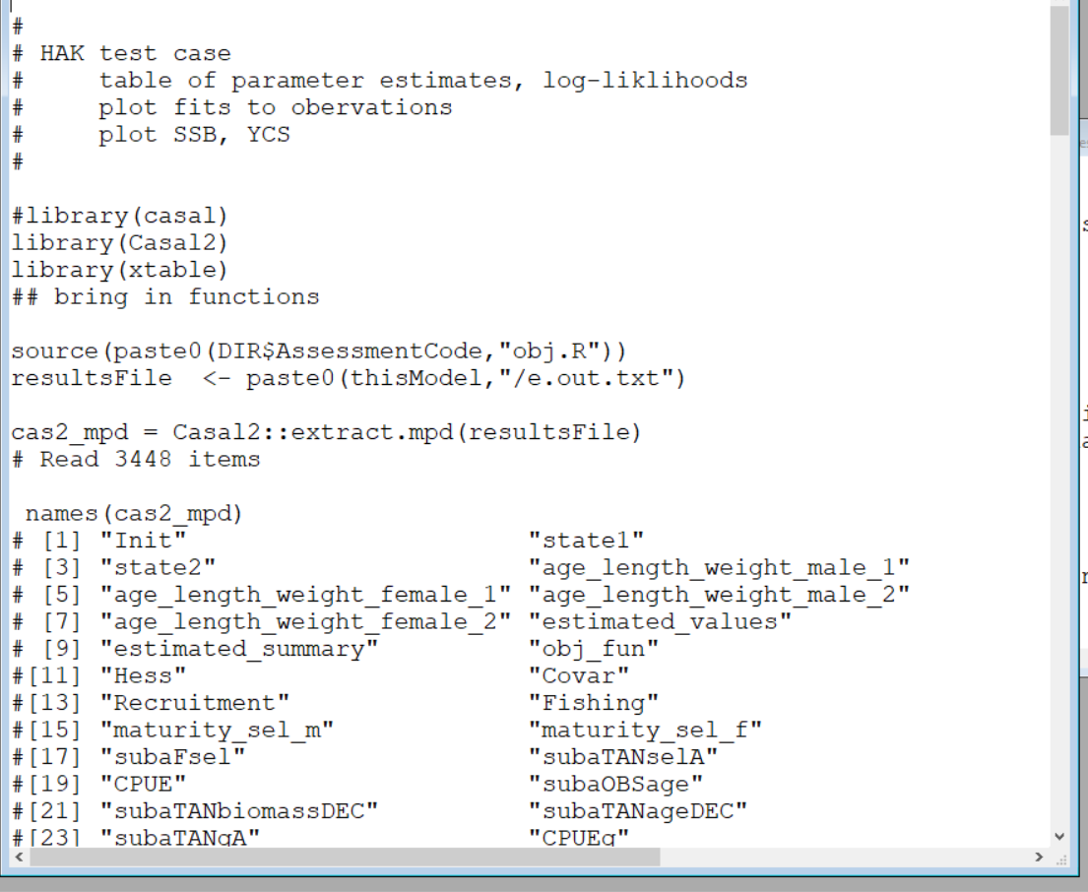
(2)HAK.get.results.R

Slide 38
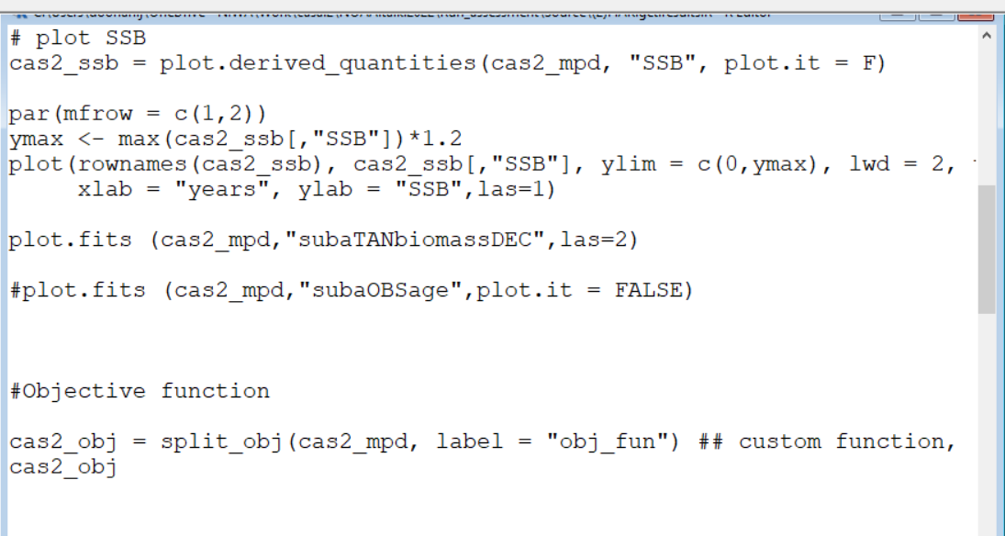

Slide 39
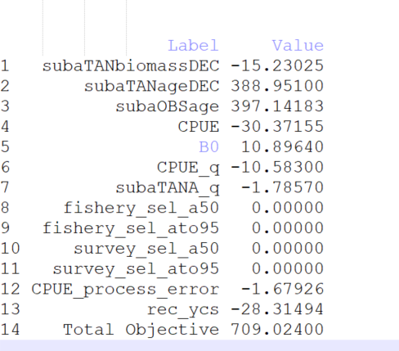
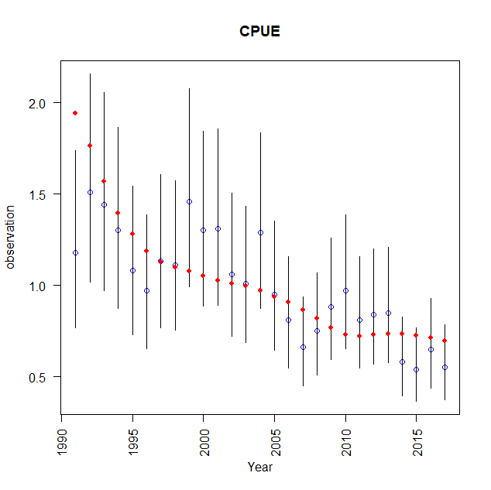
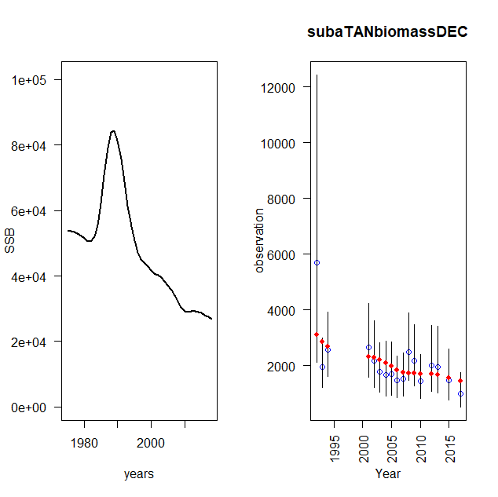
Objective function

Slide 40
Now example syntax of the input files
After the examples, go through relevant blocks for HAK 1

Slide 41
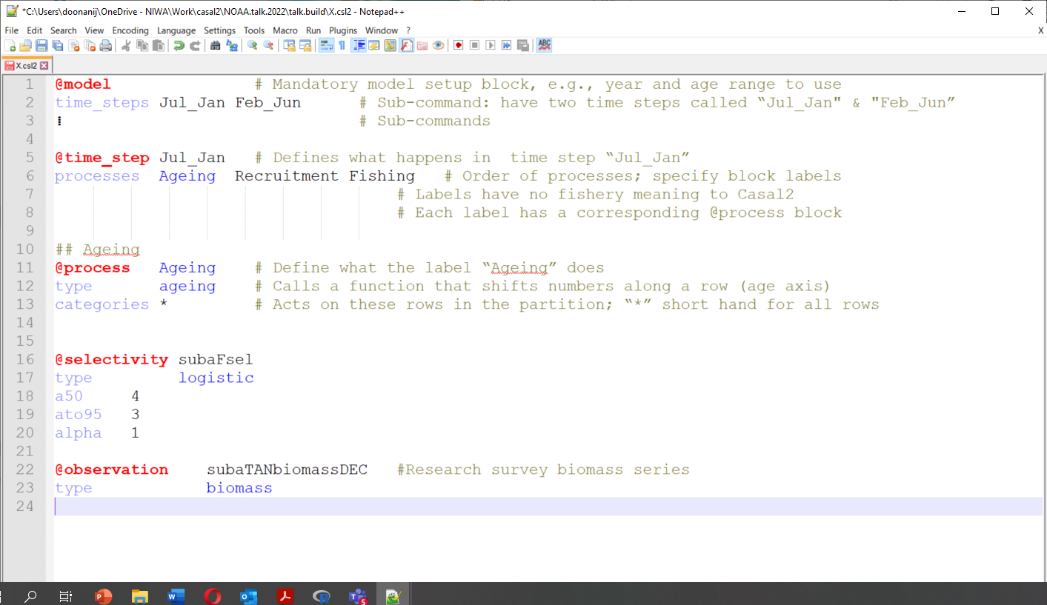
Casal2 input file specification
Input file consists of a series of command blocks
Each block specifies some aspect of the model structure or processes to act on the partition
“@” marks start of a command block
A new “@” marks the end of the preceding block
@command <label>
type <type>
#A logistic selectivity with label “subaFsel”
# initial values for logistic parameters

Slide 42
Casal2 input file specification
Whitespace can be used freely. Tabs and spaces are both accepted
You can include another file from anywhere (!include <filename>)
Included files are placed inline, so you can continue a block in a new file
A hierarchical tree structure of blocks
@model is top level block
→ must be encountered first [ !include do not count]

Slide 43
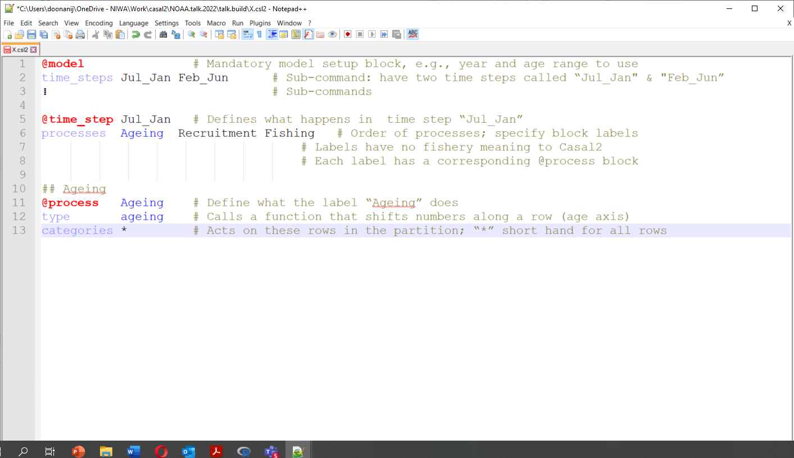
Casal2 input file specification
Syntax

Slide 44
Casal2 input file specification
Keywords & key-characters
“@” block identifier
“,” separates components in a list, e.g., male,female
“*” wildcard
“:” range, e.g., 1951:2010
“+” join operator, e.g., male+female = observation is for combined sex
“#” start of a comment, ignored by Casal2
“/*” “*/” encloses multiline comments
“type” sub-command for most blocks
Cannot be used in labels or parameter names

Slide 45
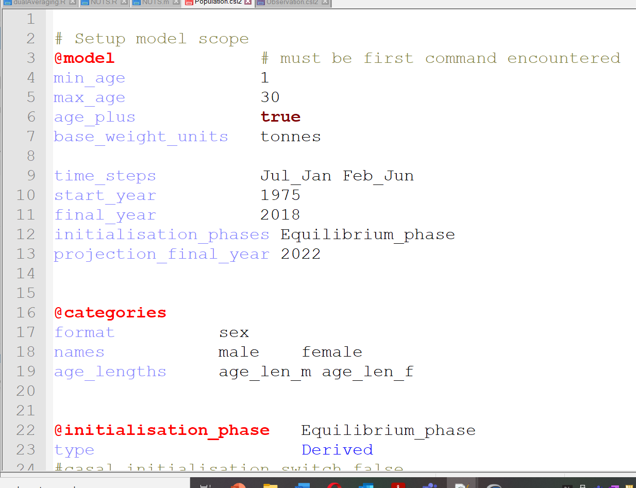
HAK 1: scope model
@model command
Two sex, ages 1 to 30
Two time-steps
Model years defined
How to get initial state
specify the initialization method

Slide 46
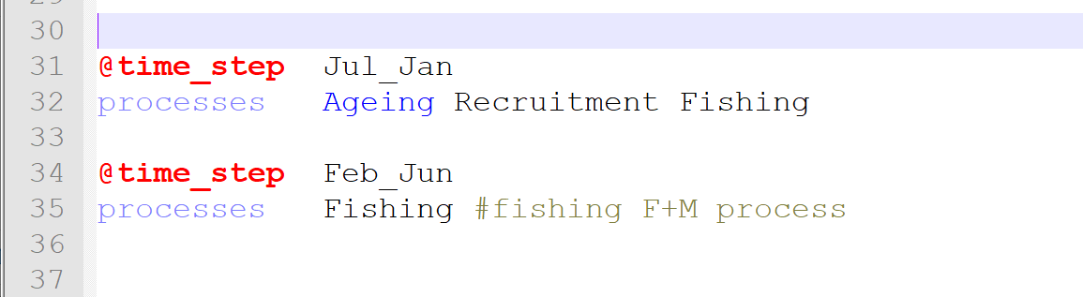
HAK 1: define processes to use & their order
Note the “Ageing”, “ Recruitment”, and “Fishing” are labels to other blocks

Slide 47
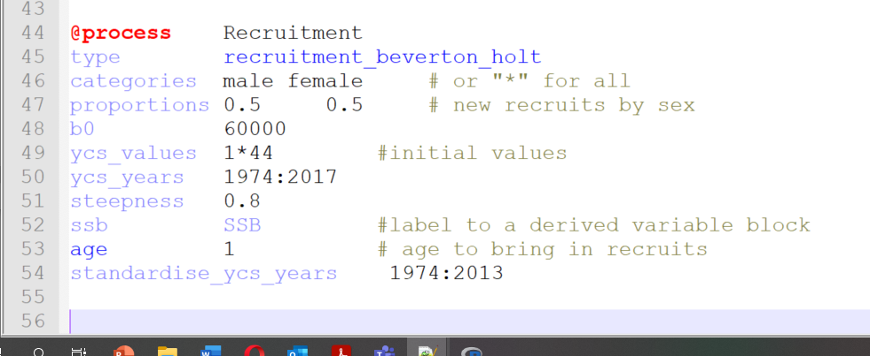
Recruiment

Slide 48
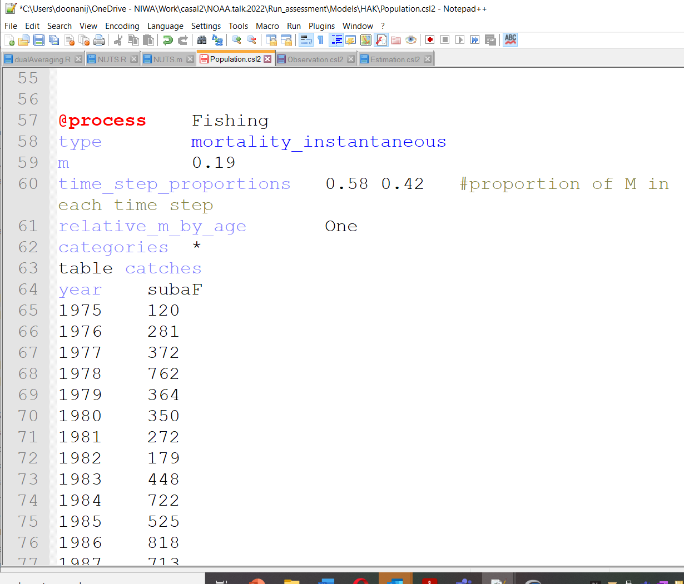
Fishing process
Have M and fishing at the same time
mortality_instantaneous
Note table keyword
has end_table at the end (next slide)
Fishery name is “subaF”

Slide 49
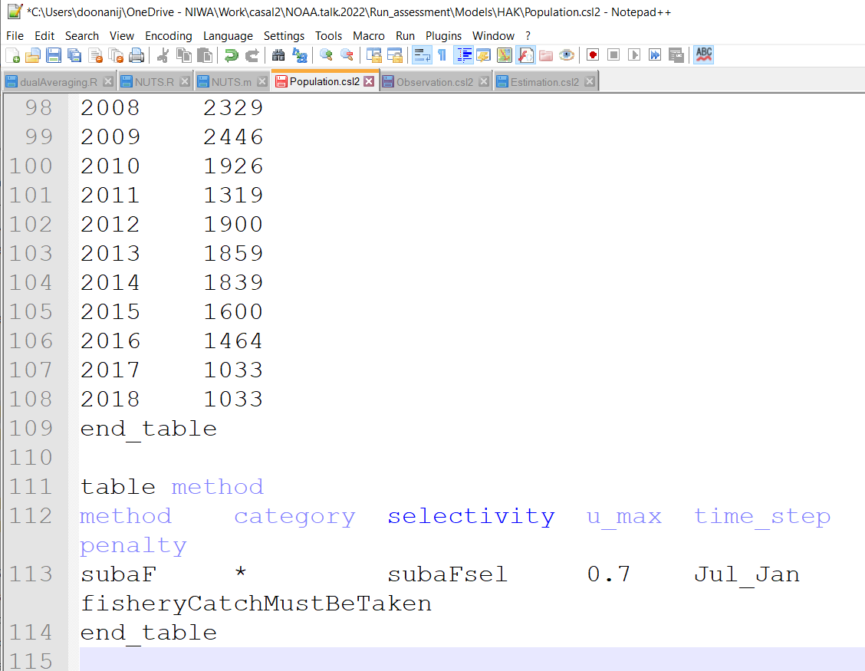
Fishing process continued
table method
defines selectivity, time-step etc

Slide 50
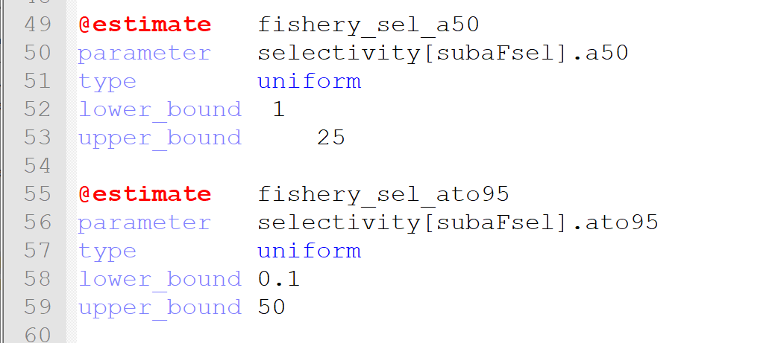
Example @estimate blocks
Note parameter names
<command>[<label>].<parameter>
type = prior

Slide 51
Casal2
LICENSE :
GNU GENERAL PUBLIC LICENSE
Copyright c 1989, 1991 Free Software Foundation, Inc.
Funding to date:
Source code and installations
Current active development team: Scott Ramsussan, Teresa A’mar, Alistair Dunn, Matt Dunn, Steven Holmes, Craig Marsh, and Ian Doonan
Code used: https://github.com/NIWAFisheriesModelling/CASAL2/blob/master/Documentation/Presentations/Run_assessment.zip
https://github.com/NIWAFisheriesModelling/CASAL2/releases/tag/v21.11
New Zealand Ministry for Primary Industries (now Fisheries New Zealand division) and
National Institute of Water & Atmospheric Research Ltd. (NIWA).
https://github.com/NIWAFisheriesModelling/CASAL2

Slide 52
Thank you Ian Doonan +64 4 3860825 Ian.Doonan@niwa.co.nz

Slide 53
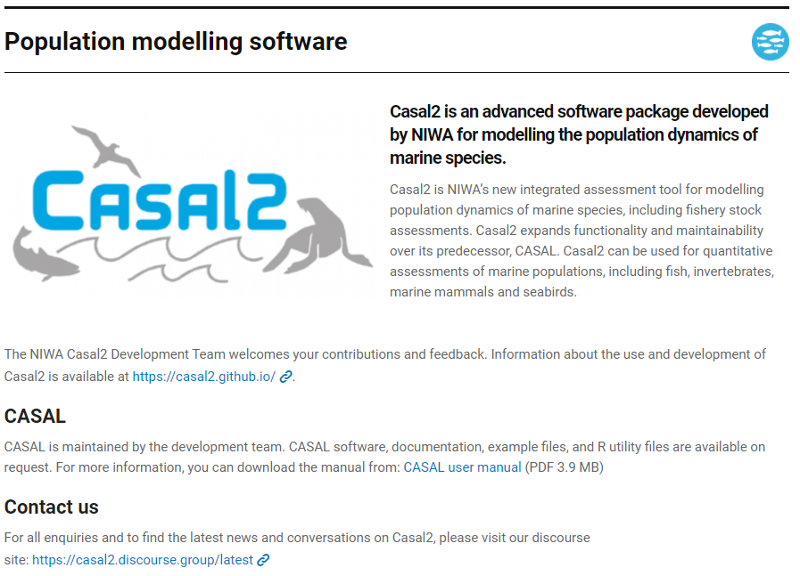
To find resources or get in touch:
Type “NIWA Casal2” into Google and click on the first entry
Click on this link to go to the io page
Click on this link to go to the Discourse page

Slide 54
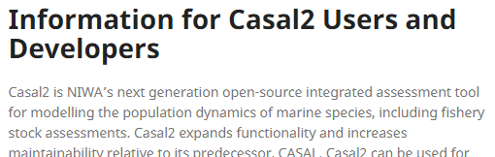
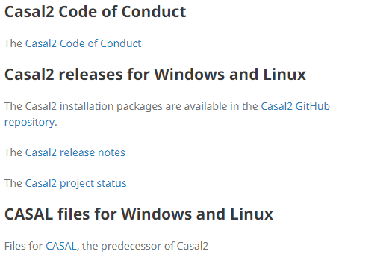
https://casal2.github.io/
First Port of Call:

Slide 55
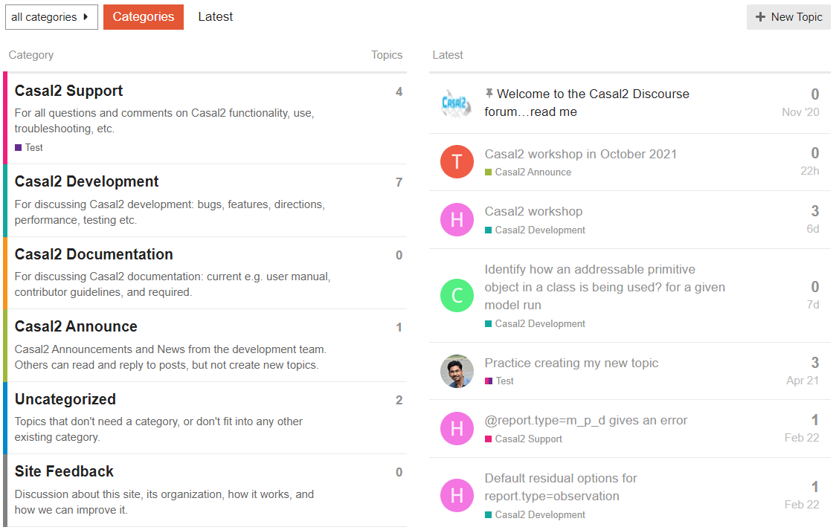
https://casal2.discourse.group/
Discourse site:

Slide 56
Software design
Integrated custom build wrapper (python).
Integration with Google's Unit Test and Mock frameworks
Definition of the coding standard to the Google C++ coding style
No exception handling
Highly modular/component architecture

Slide 57
Modern code architecture and code standards
Employed a professional developer
Scott Rasmussen
Higher chance of the code meeting performance criteria
Enhances long term maintainability
Forced coding standard
State machine (mimicked)
Loose coupling, high cohesion modular design
Greater chance of implementing modern methods that take advantage of available technologies

